Slide 1
JOB ANALYTICS -2 FOR LINKEDIN JOBS

Slide 2
SACHIN KUMAR
PD15_079
NIKHIL MOGRE
PD15_336
DEEPAK KUMAR VERMA
TEAM MEMBERS
ML GROUP-1
PD15_286
ABHISHEK RANJAN
PD15_032
PIYUSH RAMGIRWAR
PD15_017
MUHAMMED SAJID ASU
PD15_312

Slide 3
WHAT’S COMING?
INTRODUCTION
WEB SCRAPING
TOOLS USED
INSIGHTS
DASHBOARD
CHALLENGES FACED
WHAT WE LEARNED
DEPLOYMENT

Slide 4





JOB ANALYTICS
STEP 1
STEP 2
STEP 3
STEP 4
STEP 5
STEP 6
STEP 7
STEP 8
Study the problem statement. Inspecting LinkedIn Website.
Web Scraping
Using Selenium and
BeautifulSoup
Data Cleaning and Data Pre-processing
Import Data into SQL
Finding Insights
Visualizing Data
Using EXCEL.
And driving Conclusions
Building API and Preparing HTML and CSS code.
Hosting by PythonAnyWhere

Slide 5




Slide 6
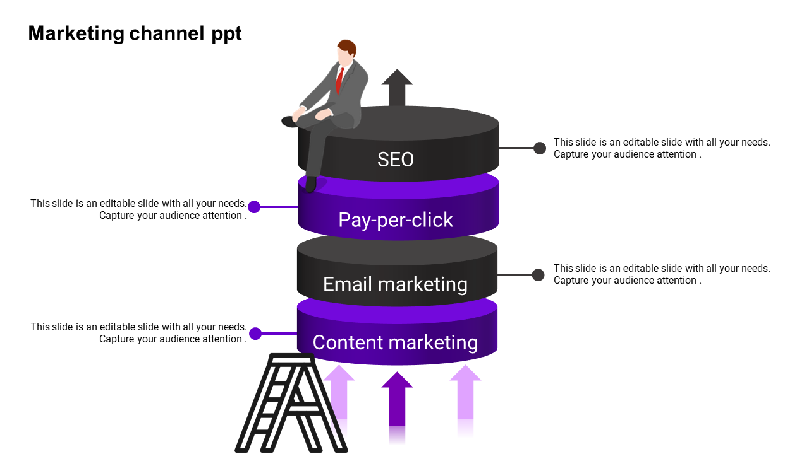
TOOLS USED
For MANAGING THE DATA in a organised manner.
And visualize it in the form of dashboard.
EXCEL
Designing and Deployment of the Job Search Page and Job application portal for jobs posted on LinkedIn.
HTML, FLASK
SQL
Divided the whole data in three insightful tables using the concept of Primary And Foreign Key. Writing queries for extracting insights and conclusions.
Python was the backbone of our project, 70% project was dependent on Python. We used different libraries and packages like BEAUTIFULSOUP and SELENIUM to scrape data. PANDAS for converting the data into a data frame and then into CSV.
PYTHON
(SELENIUM, NLTK)

Slide 7
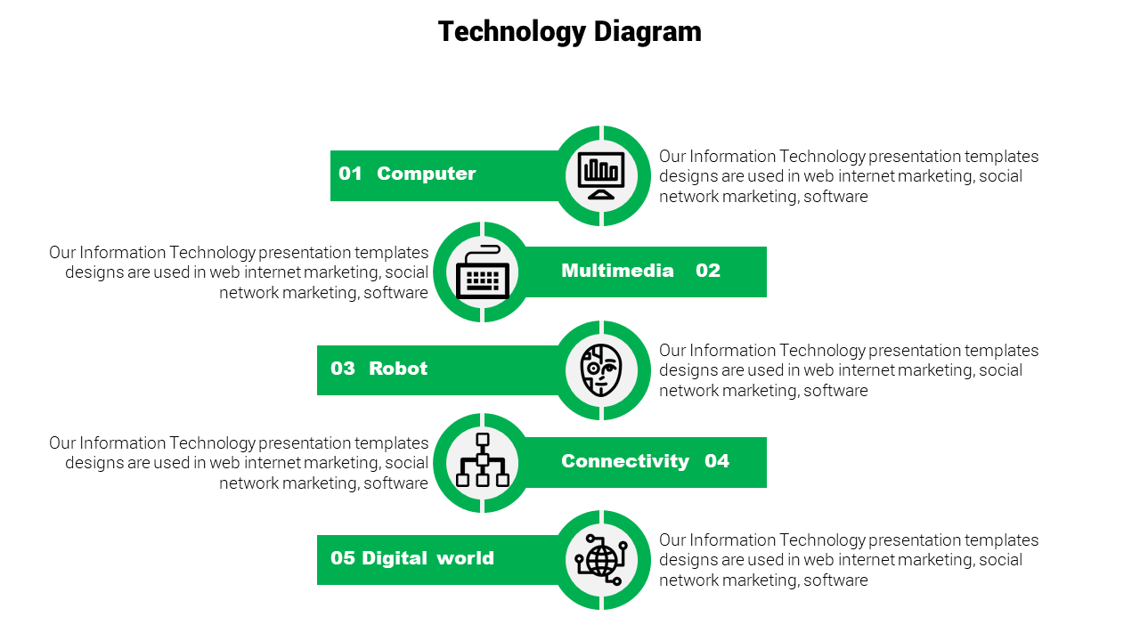
he
INSIGHTS DRAWN
We studied the trend of jobs being offered by various companies
and found that there are more job opportunities for Analysts as compared to that of Software related jobs.
01 DATA VS BUSINESS ANALYSTS
We observed that the openings in large firms are greater than that in comparatively smaller firms
.
02 EMPLOYESS <100 VS >1000
Our research and observations states that METROPOLITAN and comparatively more developed cites are leading in providing most jobs across INDIA.
03 CITIES OFFERING MOST JOBS
GENPACT, PWC, JLL, BNP PARIBAS and PFIZER are the top 5 companies in terms of offering the number of jobs opportunities.
04 COMPANIES WITH MAXIMUM OPPORTUNITIES
From our research and analysis we found out the highest number of openings are for the MID SENIOR LEVEL JOBS, and DIRECTOR jobs were least.
05 JOB LEVEL WITH MAXIMUM OPENINGS
*all the above Insights and Observations are based only on data that we have fetched from LinkedIn.

Slide 8
SOME MORE INTERESTING
INSIGHTS
he
Data Suggest that IT SERVICES, FINANCIAL SERVICES, BANKING and BUSINESS CONSULTING are the industries more popular among the applicants.
06 APPLICANT’S INDUSTRY CHOICE
Most of the applicants are aiming for leading companies in their sectors and a trend of less applications are seen in not so popular firms.
07 APPLICANT’S CHOICE OF COMPANY
Applicants these days are really smart, they keep in mind a lot of factors before applying for a job .People applying for the jobs at companies which have large number of followers.
08 ARE APPLICATIONS DEPENDENT ON FOLLOWERS
UNILEVER being favorite among people on LinkedIn having most number of followers . EY, PEPSICO and WIPRO are next in the line in terms of LinkedIn followers.
09 COMPANIES WITH MAXIMUM FOLLOWERS
IT and SOFTWARE sectors are leading on LinkedIn in terms of followers, followed by Consumer Electronics and Finance sector.
10 INDUSTRIES WITH MOST FOLLOWERS
*all the above Insights and Observations are based only on the data that we have fetched from LinkedIn.

Slide 9

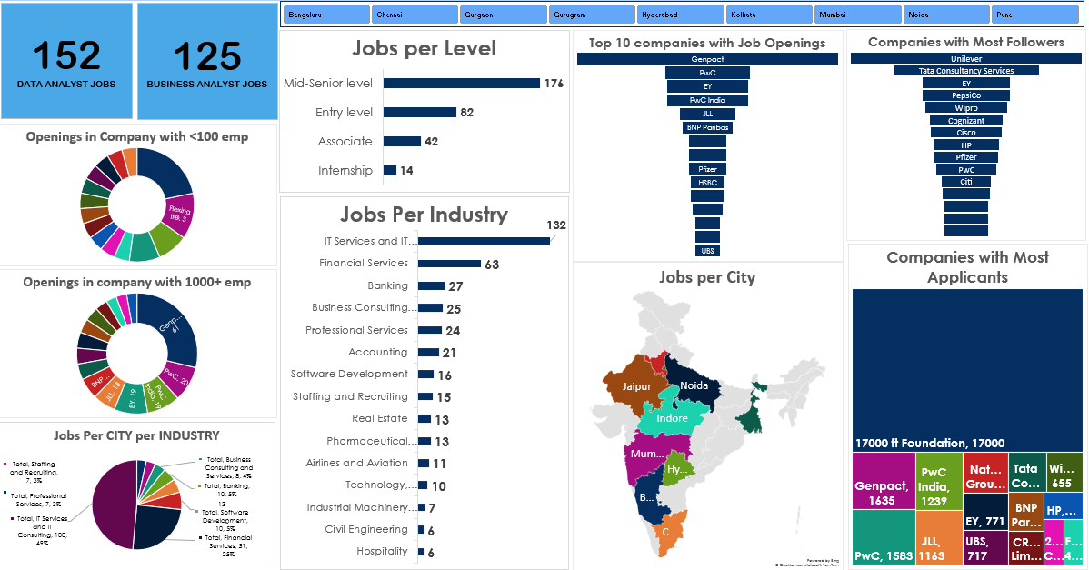
JOB ANALYTICS - 2 DASHBOARD

Slide 10
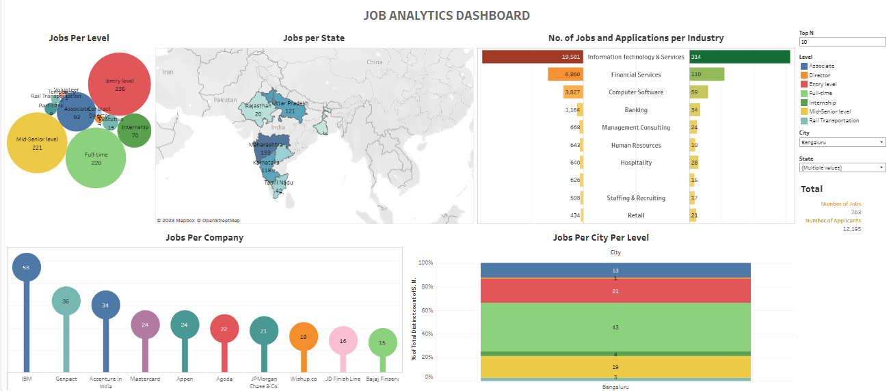
JOB Analytics Dashboard Page

Slide 11
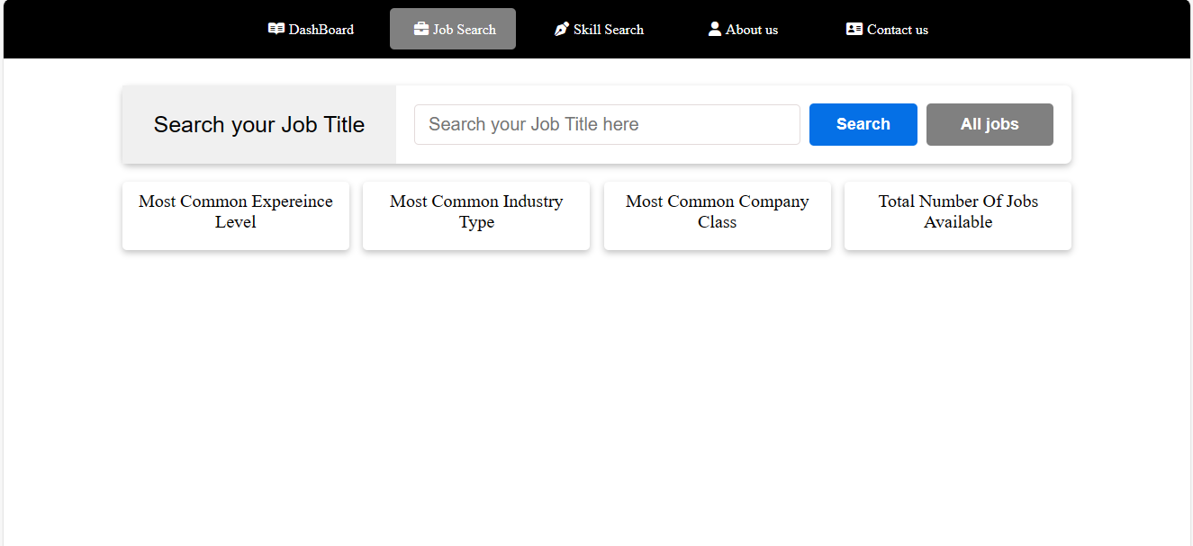
JOB Analytics Job Search Page

Slide 12
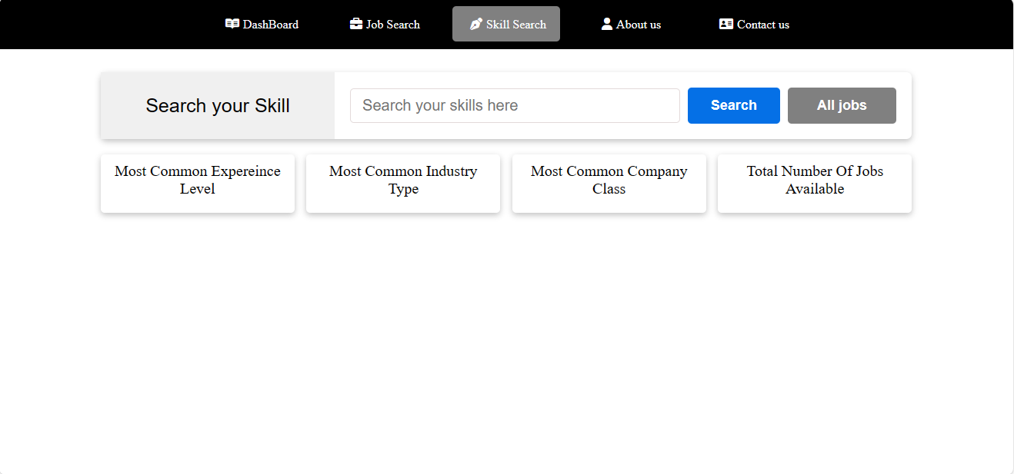
JOB Analytics Skill Search Page

Slide 13
CHALLENGES FACED
01
02
03
DATA SCRAPING
CONNECTING WITH SQL
BUILD API
Data Scraping made our lives a roller-coaster ride. SELENIUM and BEAUTIFULSOUP were new to us. So that became the biggest challenge for us.
Connecting Data with SQL using SQL Alchemy Library for finding Insights.
Building API using Flask and Hosting API using Pythonanywhere

Slide 14
WHAT WE ARE TAKING WITH US
AFTER THIS PROJECT?
WEB SCRAPING: Working knowledge on Python Packages like Selenium, BeautifulSoup, Requests, Keys, Drivers, Time, etc.
01
Major Leanings
DATA CLEANING and Connecting tables by assigning PRIMARY KEY and FOREIGN KEY with references
02
Building API using Flask and Hosting API using Pythonanywhere.
03
Team Work and Handling Pressure of close Deadlines.
04

Slide 15

This is the END of our Presentation.
And your turn to ask us anything related to the project

Slide 16


